Slide 1

How I Cleared Certification
1. Generative AI
Prompt Engineering
Copilot Concepts
Took 3-4 weeks gap to take certification
Easy, Theoretical questions, No Use cases, No Coding questions
2. Github Accelerator Program
Overview of GitHub copilot
Practical usage

Slide 2

Strategies And Practices
No Strategies, But Marked the Exam date
Practices :
Use GitHub Copilot
Install Plugins in IDE & Explore
Commands like /slash, /test
Utilize AI's for Practice/Knowledge test
Youtube for References

Slide 3
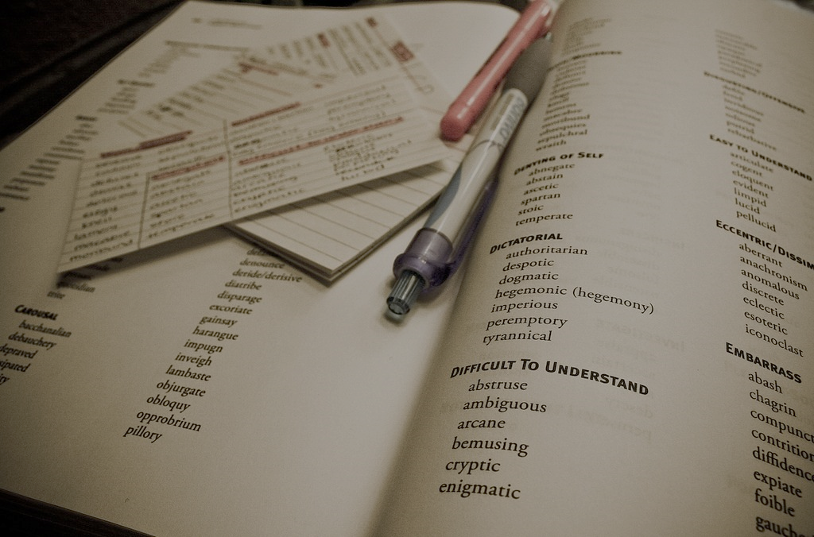
Sample Questions
3. Which Copilot Enterprise features are available in all commercially supported IDEs?
Inline suggestions
Chat
Knowledge bases
Pull request summaries
1. GitHub Copilot can generate:
Only comments
Code snippets, comments, and documentation
Only function names
Only variable names
2. What is a common use case for GitHub Copilot in testing?
Writing code
Generating test cases and test data
Managing repositories
Tracking issues
4. What reasons could apply if code suggestions are not working in your editor? (Select three.)
You do not have an active internet connection
Your programming language is not supported
Your content exclusion is active and blocks the use of GitHub Copilot
You do not have a valid GitHub Copilot license
e. You are working in files included in your .gitignore

Slide 4

Materials / References / Links
https://cognizantonline-my.sharepoint.com/:f:/g/personal/2168248_cognizant_com1/EmALq_xkNMZNgf32ECwM5-kBsNXIlvMQ7MtJYoJp1AkJcw?e=qhgugW
Github Copilot Course Recording : Video - Cognizant - GitHub Cert Accelerator Program - GitHub Copilot(20th Dec'24) | Cognizant Academy
Sample Questions Pdf’s : ( Strictly For “Practice” Only )
Pdf-1 : Github Copilot Certification Exam Questions
Pdf-2 : Github Copilot Sample Questions
Pdf-3 : Github Copilot Certification Practice Questions
Pdf-4 : Github copilot Questions by Github Copilot
References :
Basics : https://www.youtube.com/live/6D0iOzEc_QE?si=E7l-w0ejzhsuekmX
Plans & Features : https://www.youtube.com/live/uOWu0swjC_M?si=Scz26FRUKd8OwHet

Slide 5

Any Questions ??

